Slide 1
PEXISEN is my new school!
September 2022

Slide 2
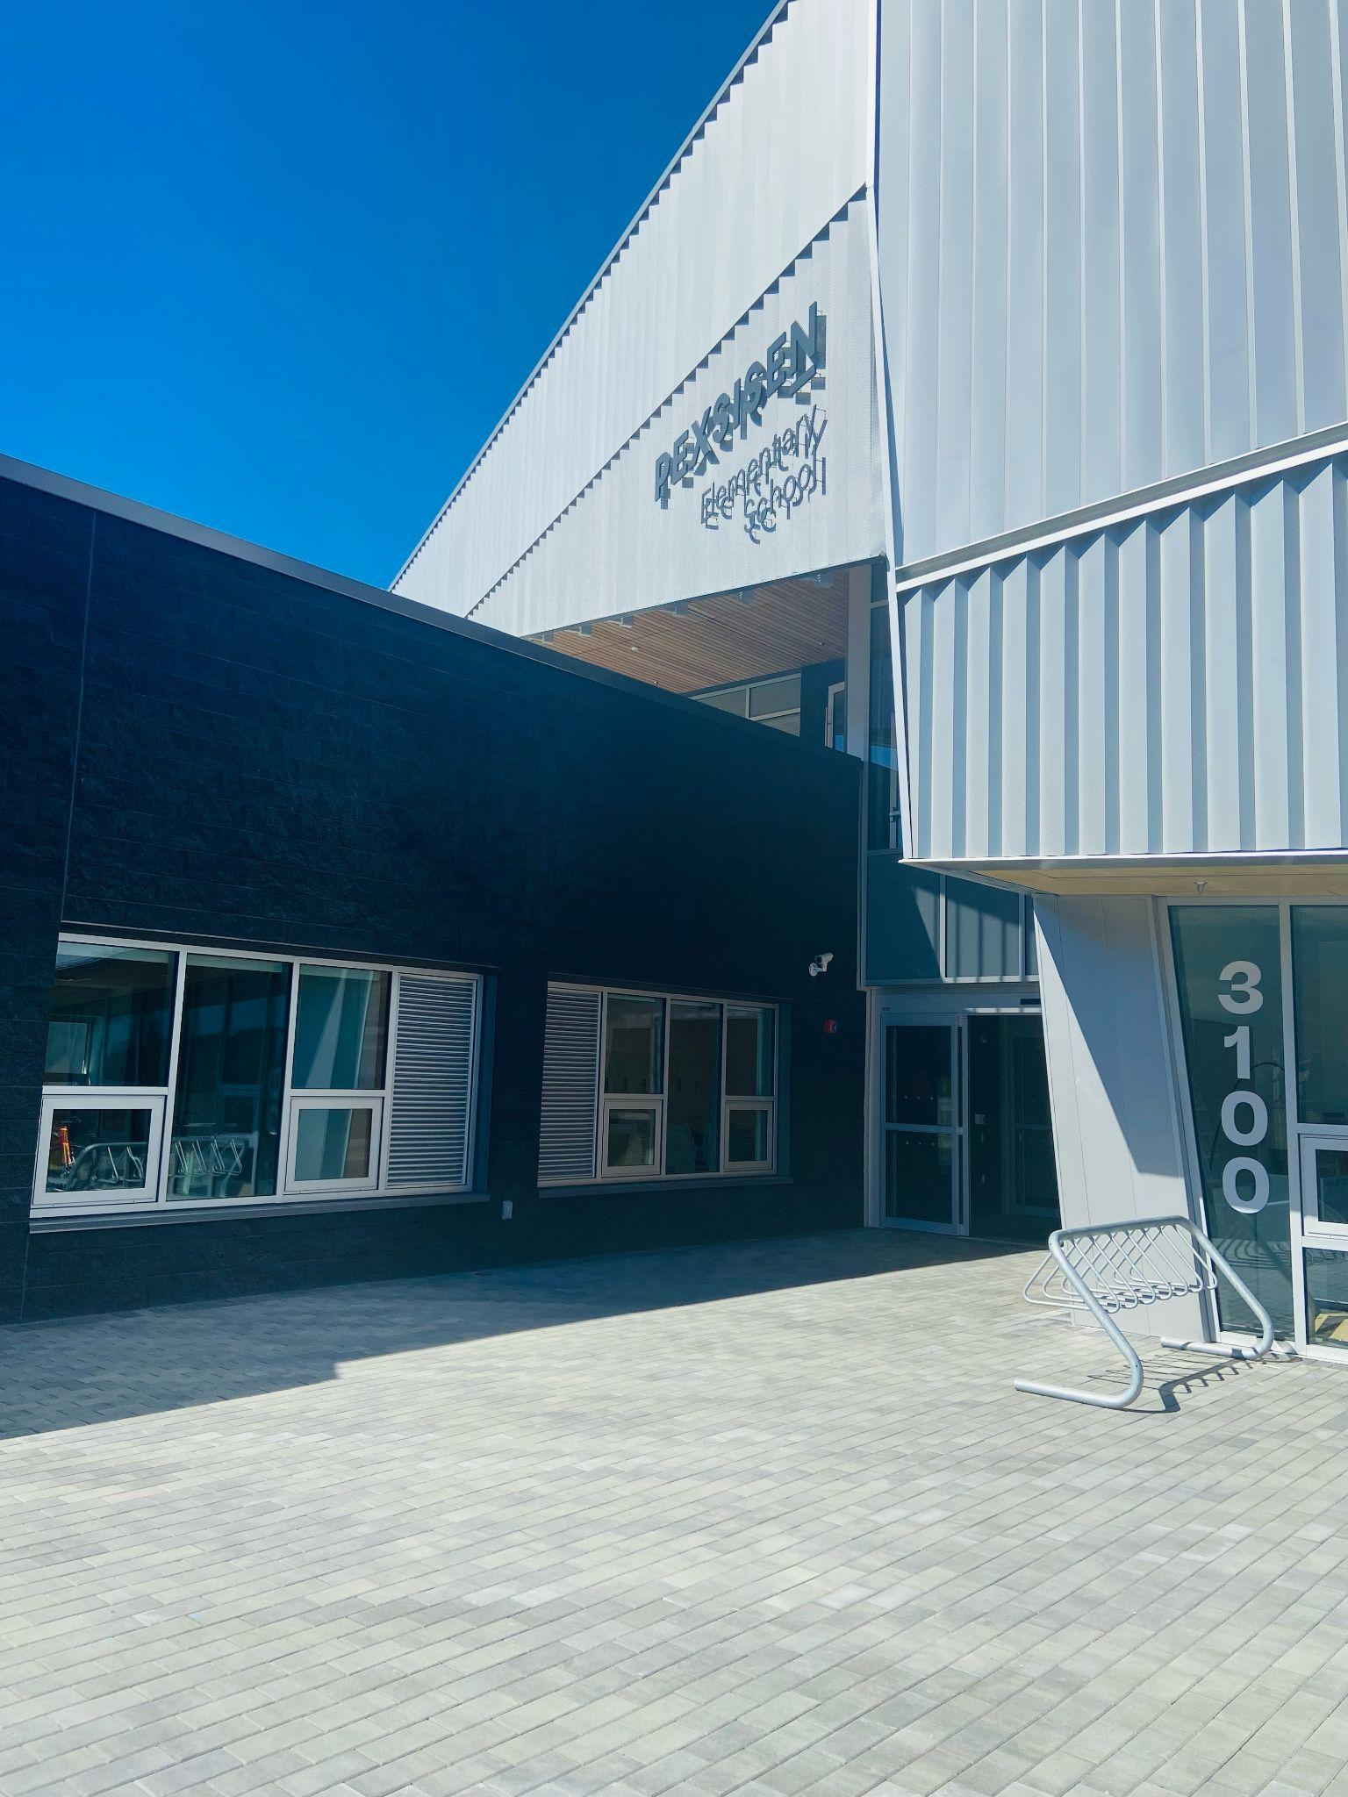
This is my new school!

Slide 3
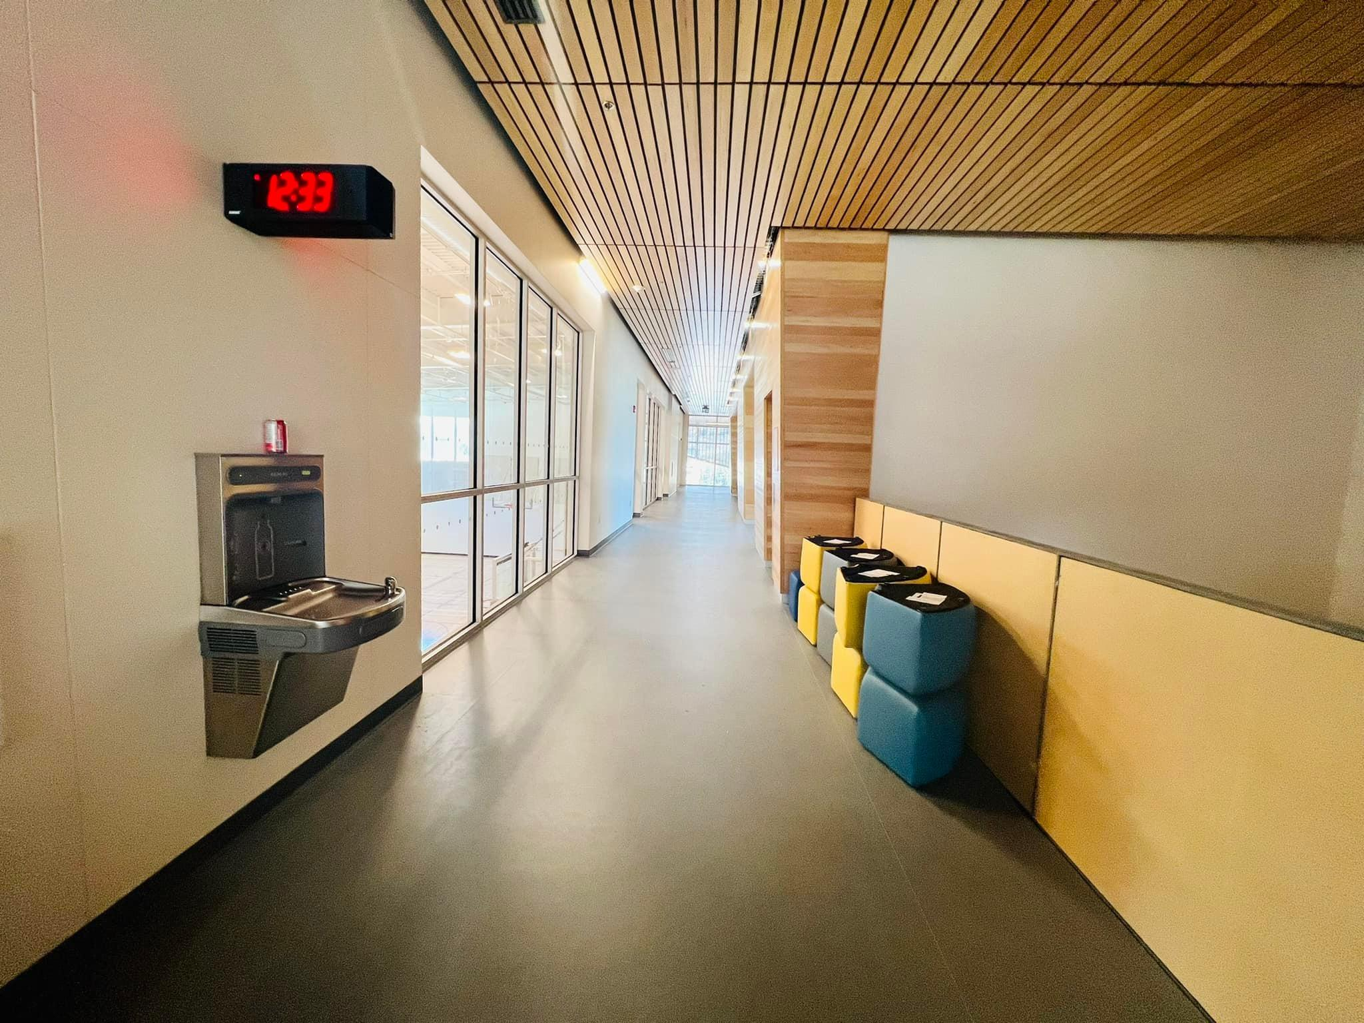
This is what the hallway looks like.

Slide 4
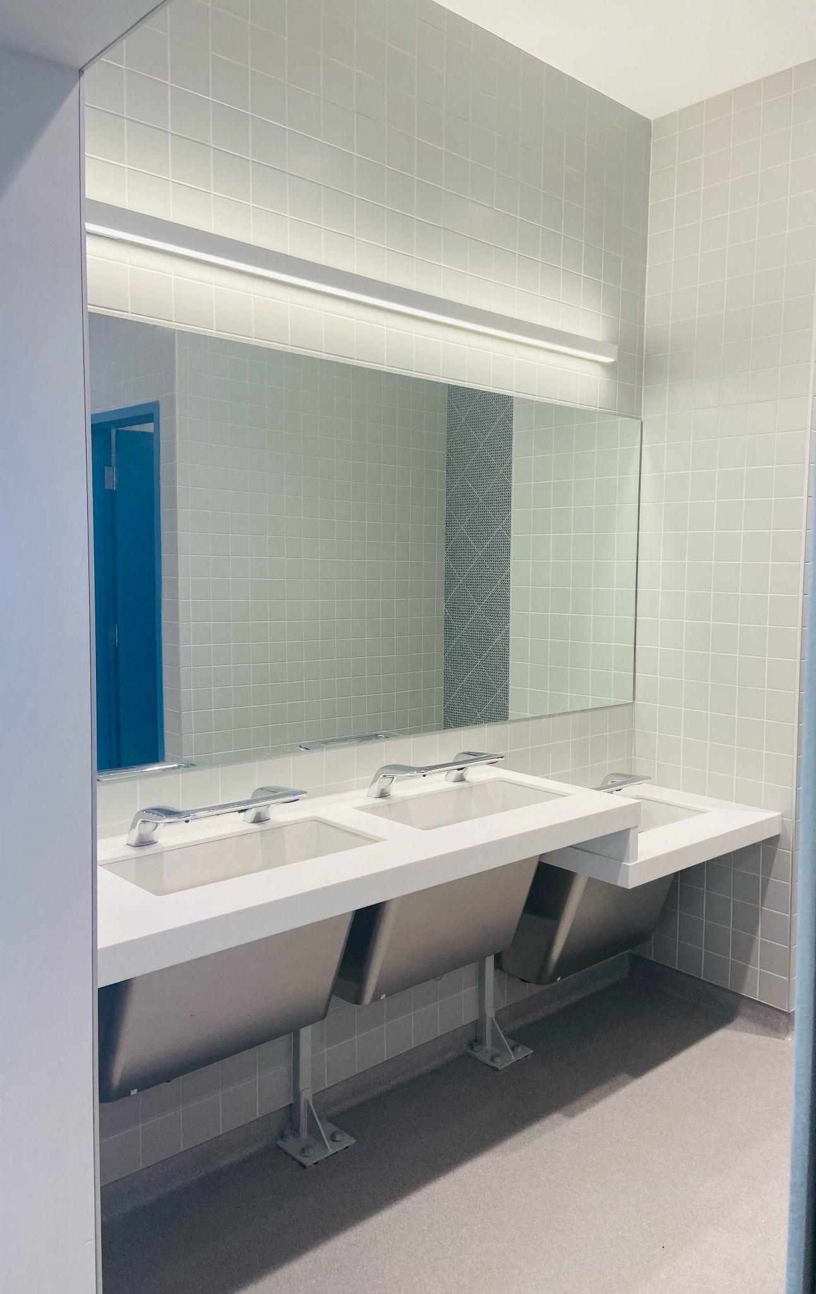
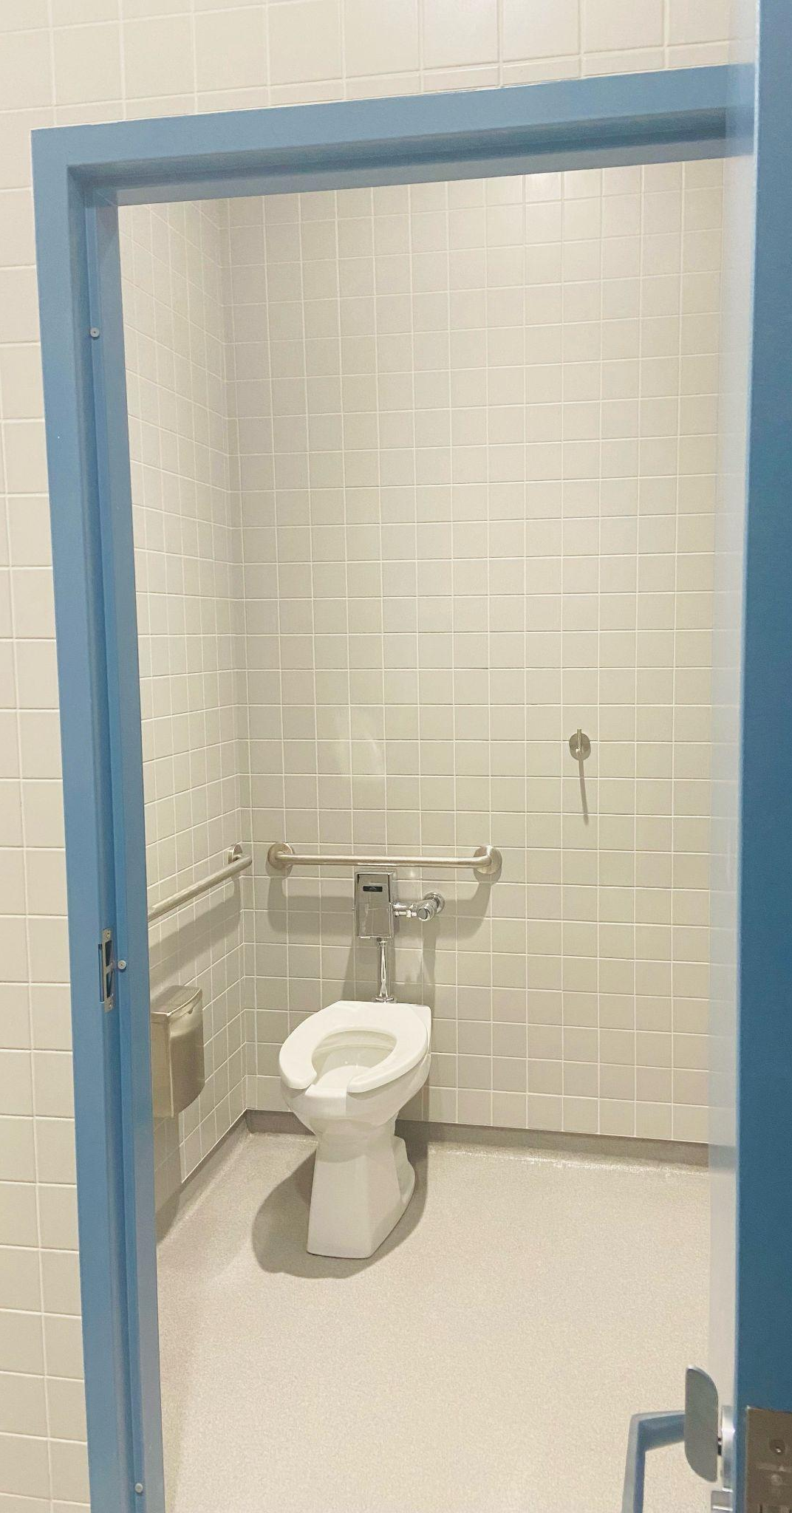
There are washrooms I can use.

Slide 5
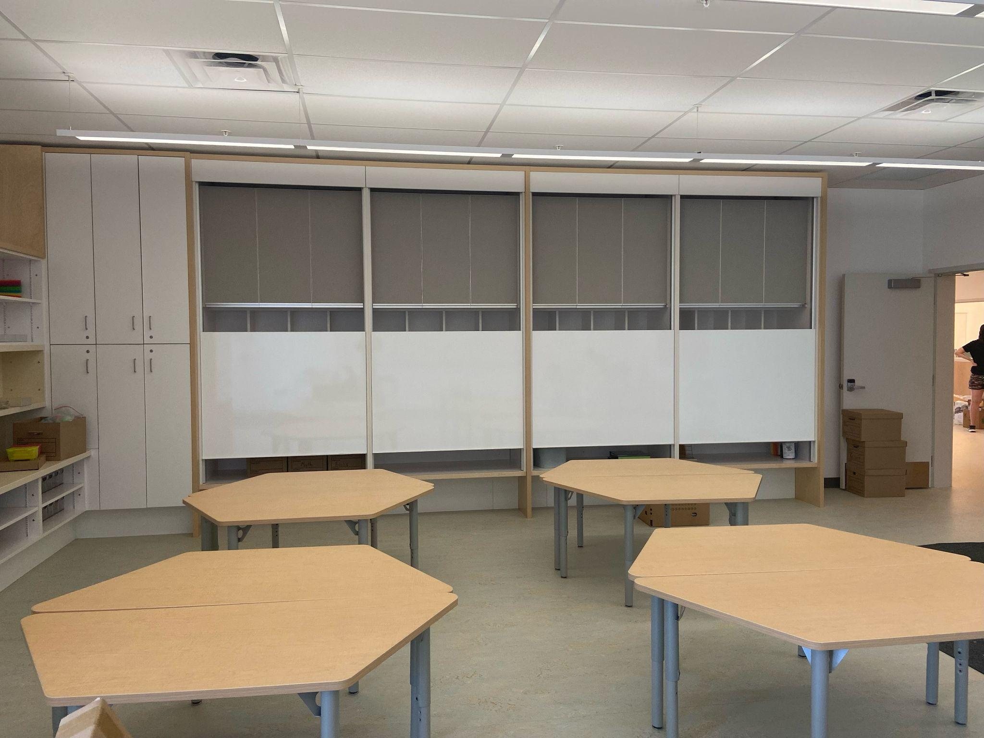
This is one of our classrooms.

Slide 6
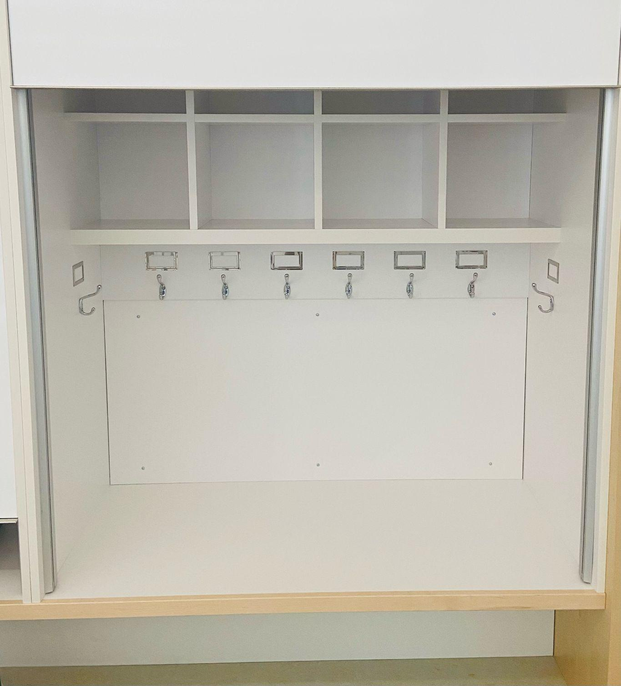
The classrooms have places for us to hang our coats and bags.

Slide 7
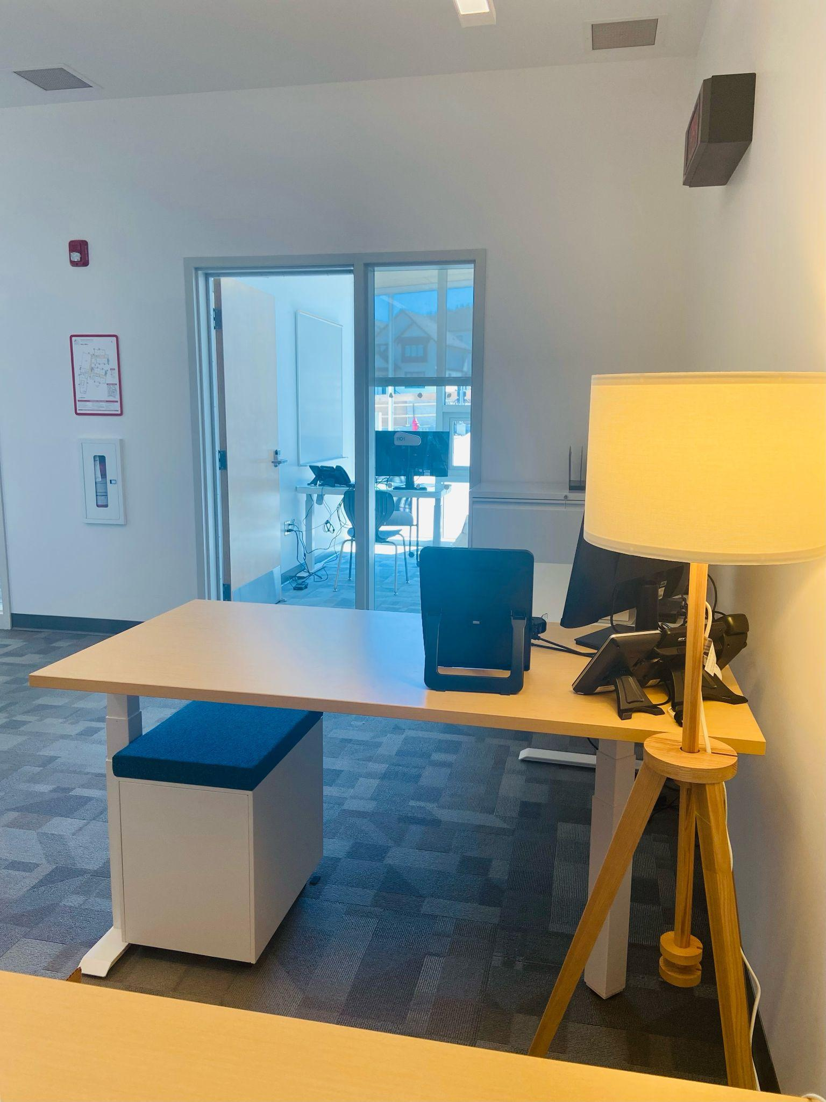
I can go to the office if I need help or if I am hurt.

Slide 8
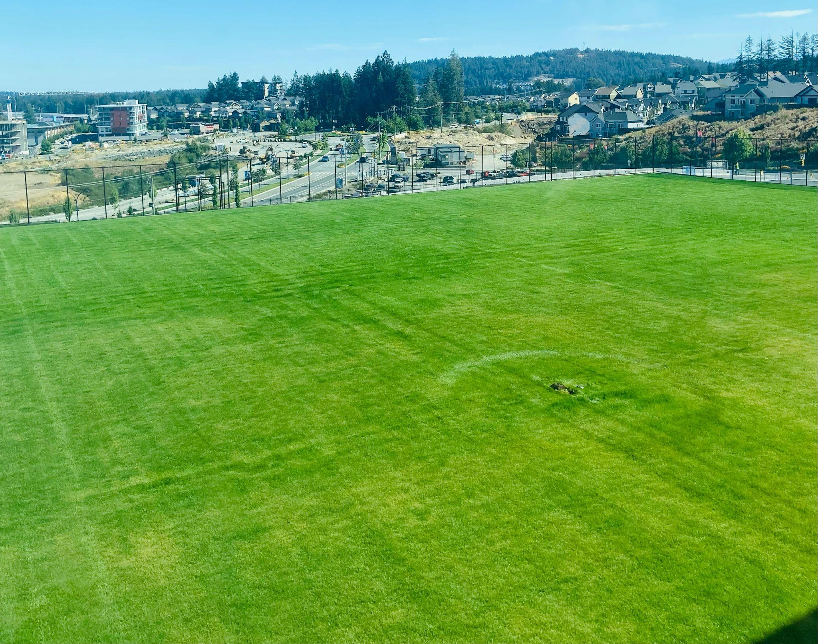
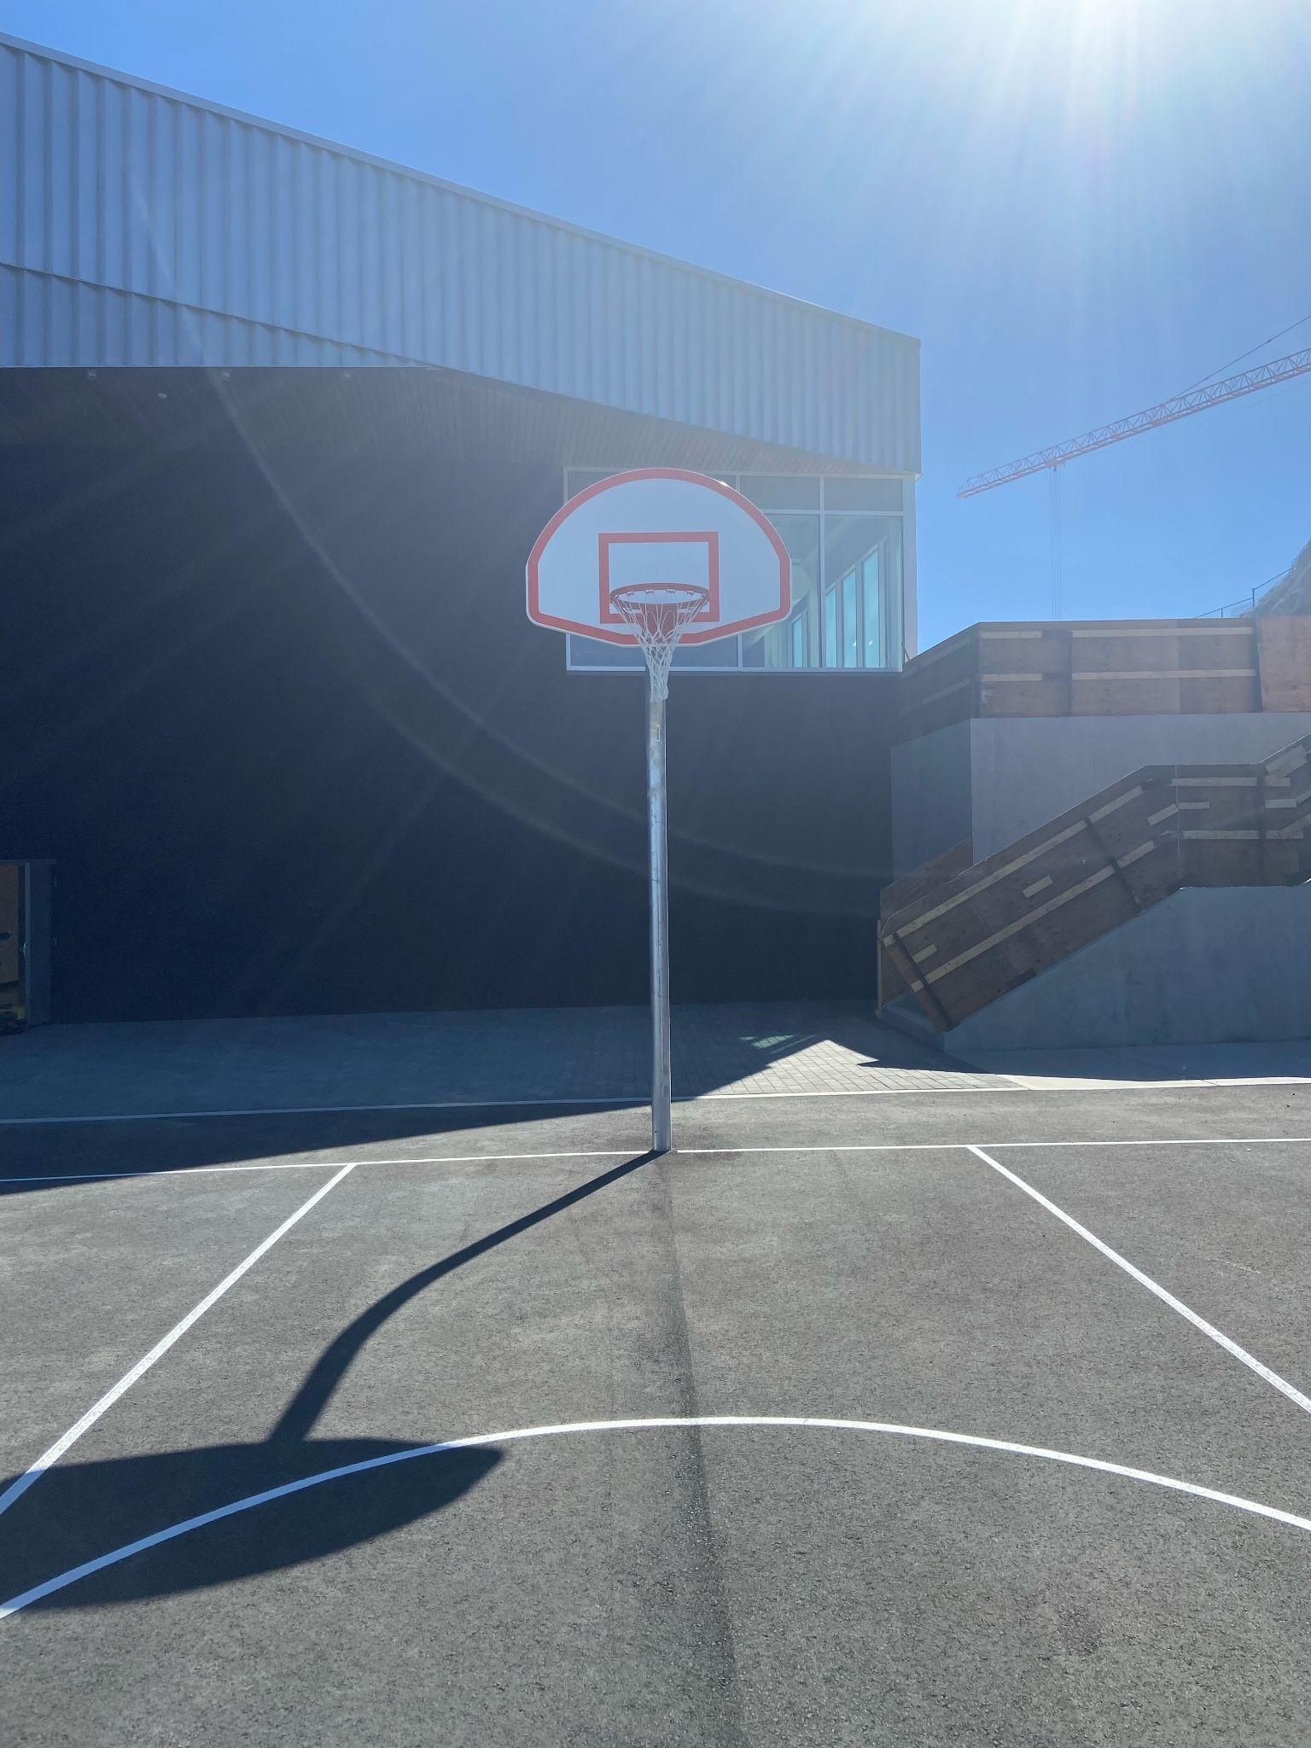
There will be fun places to play outside.

Slide 9
There will be many new people for
me to meet at my new school.
I might be nervous, but that’s normal.
I am excited to start at my new school too!

